Slide 1
Database System
CL 203
Lab 03
Data Definition Languages (DDL)

Slide 2
Data Definition Language (DDL)
Data Definition Language (DDL) statements are used to define the database structure or schema.
CREATE - to create objects in the database
ALTER - alters the structure of the database
DROP - delete objects from the database
TRUNCATE - remove all records from a table, including all spaces allocated for the records are removed
RENAME - rename an object

Slide 3
Creating a Table
Syntax
CREATE TABLE TABLE_NAME
(Column_name1 data_type [DEFAULT value],
Column_name2 data_type [DEFAULT value] ,
Column_name3 data_type [DEFAULT value], …..)
Example
CREATE TABLE customer
(Cust_id NUMBER(2), LastName VARCHAR2(14), FirstName VARCHAR2(14), Address VARCHAR2(20), Telno NUMBER(20));

Slide 4
Create Table from Another Table
Syntax:
CREATE TABLE table_name[colname1,colname2] AS [subquery];
Example:
The following example creates a table, DEPT30, that contains details of all employees working in department 30
CREATE TABLE dept30 AS SELECT empno, ename, sal * 12 ANNSAL, hiredate FROM emp WHERE deptno = 30;

Slide 5
Constraints in DDL
Constraints are certain restrictions over different tables/columns in a Database

Slide 6
1. Not Null Constraint
The NOT NULL constraint enforces a column to NOT accept NULL values. This means that NOT NULL constraint enforces a field to always contain a value.
Example:
CREATE TABLE customer (Cust_id NUMBER(2) NOT NULL, LastName VARCHAR2(14), FirstName VARCHAR2(14) NOT NULL, Address VARCHAR2(20), Telno NUMBER(20));

Slide 7
2. Unique Constraint
The UNIQUE constraint uniquely identifies each record in a database table. The UNIQUE and PRIMARY KEY constraints both provide a guarantee for uniqueness for a column or set of columns.
Example:
CREATE TABLE customer
(Cust_id NUMBER(2) NOT NULL UNIQUE,
LastName VARCHAR2(14),
FirstName VARCHAR2(14) NOT NULL,
Address VARCHAR2(20),
Telno NUMBER(20) UNIQUE);

Slide 8
Naming a Unique Constraint
(Cust_id NUMBER(2) NOT NULL ,
LastName VARCHAR2(14),
FirstName VARCHAR2(14) NOT NULL,
Address VARCHAR2(20),
Telno NUMBER(20) ,
CONSTRAINT uc_CidTelnum UNIQUE (Cust_id,telno));

Slide 9
Adding Unique Constraint in an Existing Table
ALTER TABLE Customer ADD UNIQUE (FirstName);

Slide 10
Dropping Unique Constraint
ALTER TABLE Customer DROP CONSTRAINT uc_CidTelnum;

Slide 11
3. Primary Key Constraint
The PRIMARY KEY constraint uniquely identifies each record in a database table
Example:
CREATE TABLE customer
(Cust_id NUMBER(2) NOT NULL PRIMARY key ,
LastName VARCHAR2(14),
FirstName VARCHAR2(14) NOT NULL,
Address VARCHAR2(20),
Telno NUMBER(20));

Slide 12
Naming a Primary Key Constraint
CREATE TABLE customer
(Cust_id NUMBER(2) NOT NULL ,
LastName VARCHAR2(14),
FirstName VARCHAR2(14) NOT NULL,
Address VARCHAR2(20),
Telno NUMBER(20),
CONSTRAINTS pk_custidlname PRIMARY KEY( cust_id,LastName));

Slide 13
Primary Key Constraint using Alter Table
ALTER TABLE customer ADD PRIMARY KEY (cust_Id)
To allow naming of a PRIMARY KEY constraint, and for defining a PRIMARY KEY constraint on multiple columns,
ALTER TABLE customer ADD CONSTRAINT pk_custidlname PRIMARY KEY (Cust_id,LastName)

Slide 14
Dropping a Primary Key Constraint
ALTER TABLE customer DROP CONSTRAINT pk_custidlname

Slide 15
4. Foreign Key Constraint
A FOREIGN KEY in one table points to a PRIMARY KEY in another table.
The FOREIGN KEY constraint is used to prevent actions that would destroy links between tables.
The FOREIGN KEY constraint also prevents that invalid data from being inserted into the foreign key column, because it has to be one of the values contained in the table it points to.
Example:
CREATE TABLE EMP3 ( EMPNO NUMBER(4) NOT NULL PRIMARY KEY, DEPTNO NUMBER(7,2) NOT NULL, ENAME VARCHAR2(9) NOT NULL, CONSTRAINT FK_EMP_DEPTNO FOREIGN KEY (DEPTNO) REFERENCES DEPT(DEPTNO) );

Slide 16
Foreign Key Constraint on Existing Table
ALTER TABLE EMP3 ADD FOREIGN KEY (DEPTNO) REFERENCES DEPT(DEPTNO)
Do it Yourself:
Name the foreign key constraint using alter table
Write a command to drop this foreign key constraint

Slide 17
5. Check Constraint
Specifies a condition that must be true
Example:
CREATE TABLE EMP3
(EMPNO NUMBER(4) NOT NULL CHECK(EMPNO>0) PRIMARY KEY, DEPTNO NUMBER(7,2) NOT NULL, ENAME VARCHAR2(9) NOT NULL, CONSTRAINT FK_EMP_DEPTNO FOREIGN KEY (DEPTNO) REFERENCES DEPT(DEPTNO));

Slide 18
Naming a Check Constraint
CREATE TABLE EMP3 (EMPNO NUMBER(4) NOT NULL PRIMARY KEY, DEPTNO NUMBER(7,2) NOT NULL, ENAME VARCHAR2(9) NOT NULL, CONSTRAINT FK_EMP_DEPTNO FOREIGN KEY (DEPTNO) REFERENCES DEPT(DEPTNO) CONSTRAINT chk_EMP CHECK (EMPNO>0 AND DEPTNO=’20’));

Slide 19
6. Default Constraint
The DEFAULT constraint is used to insert a default value into a column.
The default value will be added to all new records, if no other value is specified.
Example:
CREATE TABLE EMP3 (EMPNO NUMBER(4) NOT NULL, DEPTNO NUMBER(7,2) NOT NULL, ENAME VARCHAR2(9) NOT NULL,
HIRE_DATE DATE DEFAULT SYSDATE);

Slide 20
Default Constraint using Alter Table
ALTER TABLE EMP3 MODIFY hire_date DEFAULT (sysdate)

Slide 21
Dropping a Default Constraint
ALTER TABLE EMP3 ALTER COLUMN HIRE_DATE DROP DEFAULT

Slide 22
Detailed Example
CREATE TABLE DEPT (
DEPTNO NUMBER(2) constraint DEPT_DEPTNO_PK PRIMARY KEY,
DNAME VARCHAR2(14),
LOC VARCHAR2(13),
CONSTRAINT DEPT_DNAME_UK UNIQUE(DNAME));
CREATE TABLE EMP3 (
EMPNO NUMBER(4) CONSTRAINT EMP_EMPNO_PK PRIMARY KEY,
ENAME VARCHAR2(10) NOT NULL,
JOB VARCHAR2(9),
MGR NUMBER(4),
HIREDATE DATE DEFAULT SYSDATE,
SAL NUMBER(7, 2),
COMM NUMBER(7, 2),
DEPTNO NUMBER(7, 2) NOT NULL,
CONSTRAINT EMP_DEPTNO_CK CHECK (DEPTNO BETWEEN 1 AND 50),
CONSTRAINT EMP_DEPTNO_FK FOREIGN KEY (DEPTNO) REFERENCES DEPT(DEPTNO));

Slide 23
Drop Statement
The DROP TABLE statement is used to delete a table.
Syntax:
DROP TABLE table_name;
The DROP DATABASE statement is used to delete a database.
Syntax:
DROP DATABASE database_name;

Slide 24
Truncate Table Statement
If we just want to delete the data and not the table itself we use Truncate statement
Syntax
TRUNCATE TABLE table_name

Slide 25
Alter Table Statement
TO ADD A COLUMN IN A TABLE
ALTER TABLE table_name ADD column_name datatype
TO DELETE A COLUMN IN A TABLE
ALTER TABLE table_name DROP COLUMN column_name
TO CHANGE THE DATA TYPE OF A COLUMN IN A TABLE
ALTER TABLE table_name MODIFY column_name datatype

Slide 26
Unique Key vs Primary Key
1) Unique key in a table can be null, but primary key can not be null in any table in relational database like MySQL , Oracle etc. 2) Primary key can be combination of more than one unique keys in same table.
3) There can be only one primary key per table in a relation database e.g. MySQL, Oracle or Sybase, but there can be more than one unique key per table. 4) Unique key is represented using unique constraint while primary key is created using primary key constraint in any table and it automatically gets unique constraint. 5) Many database engine automatically puts clustered index on primary key and since you can only have one clustered index per table, it’s not available to any other unique key at same time.

Slide 27
Referential Integrity
Referential integrity is a property of data which, when satisfied, requires every value of one attribute (column) of a relation (table) to exist as a value of another attribute in a different (or the same) relation (table).
It is imposed through Primary and Foreign Key Constraints
It is violated through Delete and Update statements

Slide 28
Deferred Constraint Checking
Sometimes it is necessary to defer the checking of certain constraints, most commonly in the "chicken-and-egg" problem. Suppose we want to say:
CREATE TABLE chicken (cID INT PRIMARY KEY, eID INT REFERENCES egg(eID));
CREATE TABLE egg(eID INT PRIMARY KEY, cID INT REFERENCES chicken(cID));
But if we simply type the above statements into Oracle, we'll get an error. The reason is that the CREATE TABLE statement for chicken refers to table egg, which hasn't been created yet! Creating egg won't help either, because egg refers to chicken.

Slide 29
Getting Rid of the Problem
To work around this problem, we need SQL schema modification commands. First, create chicken and egg without foreign key declarations:
CREATE TABLE chicken(cID INT PRIMARY KEY, eID INT);
CREATE TABLE egg(eID INT PRIMARY KEY, cID INT);
Then, we add foreign key constraints:
ALTER TABLE chicken ADD CONSTRAINT chickenREFegg FOREIGN KEY (eID) References egg(eID) INITIALLY DEFERRED Deferrable;
ALTER TABLE egg ADD CONSTRAINT eggREFchicken FOREIGN KEY (cID) REFERENCES chicken(cID)
INITIALLY DEFERRED DEFERRABLE;

Slide 30
Dropping the Tables
Finally, to get rid of the tables, we have to drop the constraints first, because Oracle won't allow us to drop a table that's referenced by another table.
ALTER TABLE egg DROP CONSTRAINT eggREFchicken;
ALTER TABLE chicken DROP CONSTRAINT chickenREFegg;
DROP TABLE egg;
DROP TABLE chicken;

Slide 31
Alter Statement
Use the Alter Table Statement to:
Add a new column
Modify an existing column
Define a default value for the new column
Drop a column

Slide 32
Alter Table Statement
TO ADD A COLUMN IN A TABLE
ALTER TABLE table_name ADD column_name datatype
TO DELETE A COLUMN IN A TABLE
ALTER TABLE table_name DROP COLUMN column_name
TO CHANGE THE DATA TYPE OF A COLUMN IN A TABLE
ALTER TABLE table_name MODIFY column_name datatype

Slide 33
Exercise – Scenario 1
Step: 01
Create a table Faculty based on the following chart
Column | Data type | Constraints
Faculty_Id | Number (6) | Primary Key => faculty_pk
Last_Name | Varchar2(15) | Not NULL
First_Name | Varchar2(15) | Not NULL
Dept | Char(3)

Slide 34
Scenario 1
Step: 02
Create a table Department based on the following chart
Column | Data type | Constraints
Dept_Code | Char (3) | Primary Key => dept_pk
Dept_Name | Varchar2(20) | Not NULL

Slide 35
Scenario 1
Step: 03
Add a new column Location to Dept table which has data type Char(7). Save the SQL statement as ex3.sql. Confirm and validate the modification of the table.
Step: 04
Add a new FOREIGN KEY constraint (named faculty_dept_fk) to column Dept on Faculty table that refers to column Dept_Code on Dept table.
Step: 05
Increase Last_Name column to 25 characters long.

Slide 36
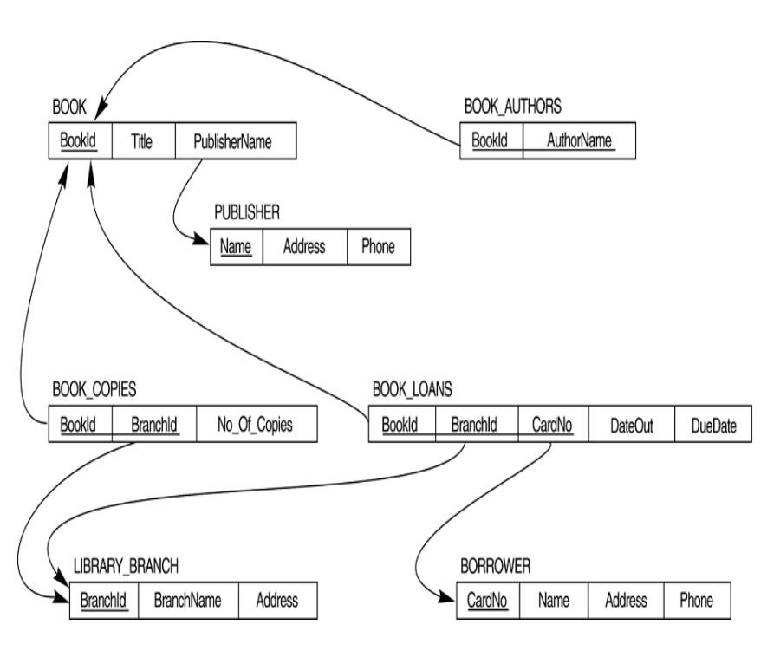
Exercise – Scenario 2 Create the following library database using SQL

